Slide 1
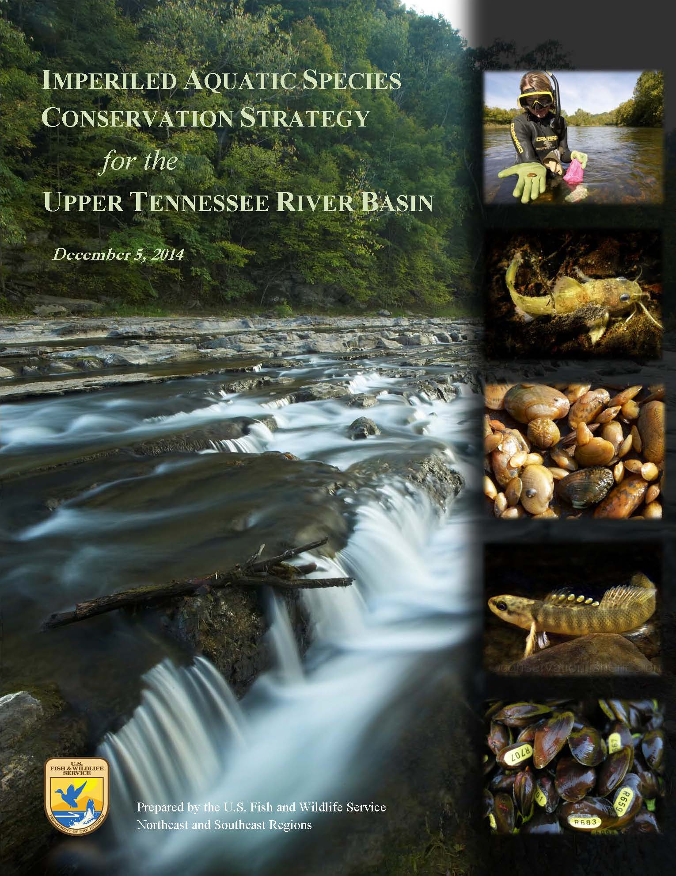
Overview
& Implementation
January 30, 2015

Slide 2
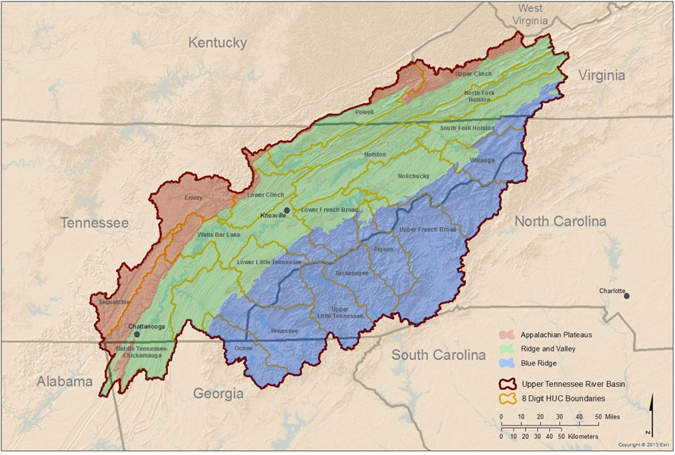
Large geographic area
(22,360 square miles primarily in VA, NC, and TN)

Slide 3
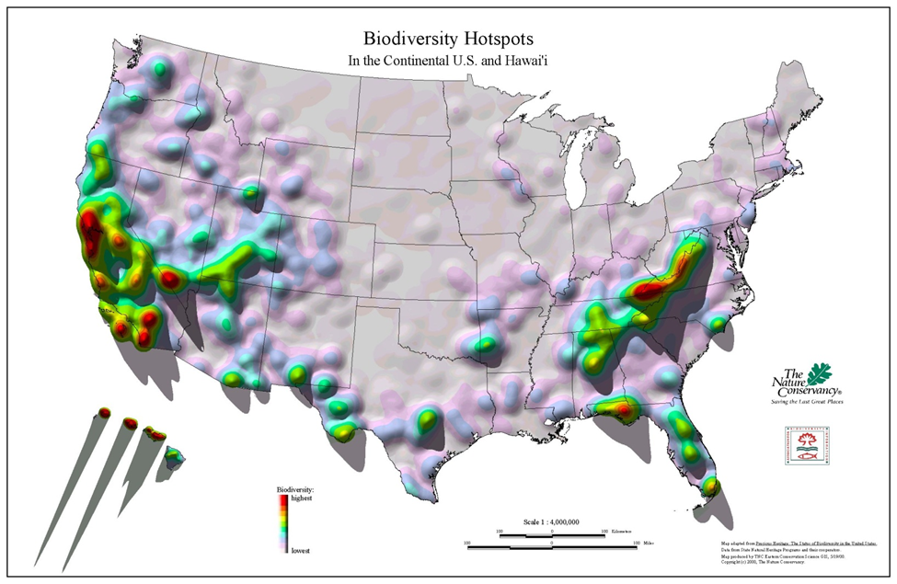
Listed, proposed, and candidate fishes (12) and mussels (24) (imperiled aquatic species)

Slide 4
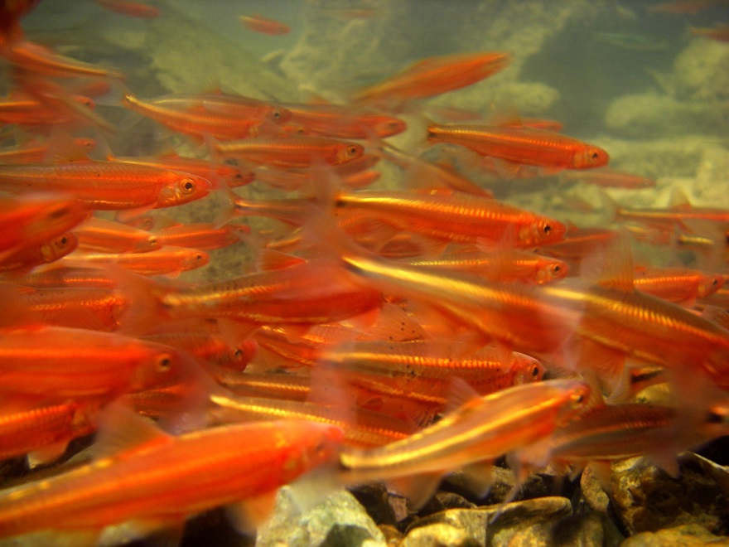
Why Develop the Strategy?
Limited FWS staff, many partners, limited budgets, extensive coordination, large number of species facing a variety of threats, large geographic area
To provide a cost effective approach to guide conservation and management of imperiled freshwater fish and mussel species in the UTRB
To achieve cost effective conservation FWS formed a team to develop a strategy
Team sought to determine what sorts of actions need to be emphasized to best achieve recovery of these species in the UTRB

Slide 5
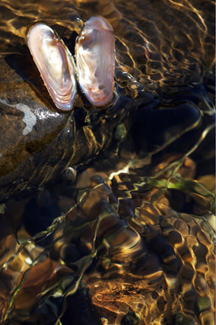
Strategy Team Members
Meredith Bartron, FWS, Northeast Fishery Center
Rick Bennett, FWS, Northeast Regional Office
Jean Brennan, FWS, Appalachian Landscape Conservation Cooperative
Bob Butler, FWS, Asheville Field Office
Stephanie Chance, FWS, Tennessee Field Office
Brian Evans, FWS, Southwestern Virginia Field Office
Catherine Gatenby, FWS, Lower Great Lakes Fish and Wildlife Conservation Office
Shane Hanlon, FWS, Southwestern Virginia Field Office
Roberta Hylton, FWS, Southwestern Virginia Field Office
Mary Jennings, FWS, Tennessee Field Office
Jess Jones, FWS, Virginia Field Office
Callie McMunigal, FWS, Appalachian Partnership Coordinator
Martin Miller, FWS, Northeast Regional Office
Mary Parkin, FWS, Northeast Regional Office
Cindy Schulz, FWS, Virginia Ecological Services
Peggy Shute, FWS, Tennessee Field Office
Dave Smith, USGS, Leetown Science Center
Kurt Snider, FWS, Tennessee Field Office

Slide 6
Conservation Partner Review of Draft Strategy
Conservation Fisheries, Incorporated
Land Trust of the Little Tennessee
North Carolina Department of Environment and Natural Resources
North Carolina Wildlife Resources Commission
Tennessee Department of Environment and Conservation
Tennessee Valley Authority
Tennessee Wildlife Resources Agency
The Nature Conservancy – NC
The Nature Conservancy – TN
The Nature Conservancy – VA
Virginia Department of Game and Inland Fisheries
Virginia Natural Heritage Program

Slide 7
Strategy
A combination of (1) the most advantageous and cost effective management approach for conserving imperiled fishes and mussels in the UTRB, (2) priority imperiled fish and mussel species for focused management consideration, and (3) priority areas for focused habitat management.
Not a rigid management prescription, intended to guide management of these resources.
Adaptability of Strategy will help FWS better integrate its efforts internally and with those of partners.

Slide 8
Population Management Emphasis Approach
Management Action Focus:
Implement ESA Section 7 and 10 regulations/influence agencies
Use available means to protect or establish populations
Increase extant populations
Establish new populations
Develop best management practices for managing stream and riparian habitat
Evaluate and monitor threats
Population viability analyses
Evaluate habitat for reintroductions
Work with partners and industry

Slide 9
Species Prioritization – Imperiled Fishes
Prioritization variables included degree of imperilment, expected conservation benefit from management actions, and management cost accrued over the next 20 years.

Slide 10
Watershed Prioritization
Species richness and management feasibility values were standardized and weighted to provide weighted average scores for prioritization.

Slide 11
Strategy Implementation
In cooperation with our partners and stakeholders
Does not direct the work of our partners; rather, prioritizes FWS efforts to make the most effective use of a limited budget and continue to complement the work of conservation partners
Make decisions regarding priority species on which to focus recovery efforts, both in terms of staff time and resource dollars
Discussing species and management priorities for expending traditional Section 6 funds and State Wildlife Grant funds with State agencies
Determining where to focus FWS recovery and restoration program (e.g., National Fish Hatchery, Partners for Fish and Wildlife, National Fish Habitat and National Fish Passage) efforts
Hosting annual planning meeting with partners to discuss completed, ongoing, and future projects that help achieve goal and objectives of Strategy – late 2015/early 2016
Review and evaluate Strategy’s effectiveness, based on monitoring results, lessons learned, and other available information, and modify or adapt Strategy as appropriate – approximately every 4 years
Explore opportunities to enhance our impact -- leverage network resources, communications, and partnership support through collaboration with Appalachian LCC

Slide 12
